Slide 1


A Survey on Recommender Systems
Candidate: Zhiqiang Guo（郭志强）
Major: Computer Software and Theory
Course: Information Retrieval
Date: December 16th, 2020
Huazhong University of Science & Technology

Slide 2

01 Background
02 Methods
03 Conclusion
04 Reference
CONTENTS

Slide 3
01 Background
02 Methods
03 Conclusion
04 Reference
CONTENTS

Slide 4

Background
01
Information Retrieval
Recommender Systems
Input information
???
User, Item, History logs
Query
VS
Query
Matching the query with all documents
Matching the query with all items
Document list
Item list

Slide 5
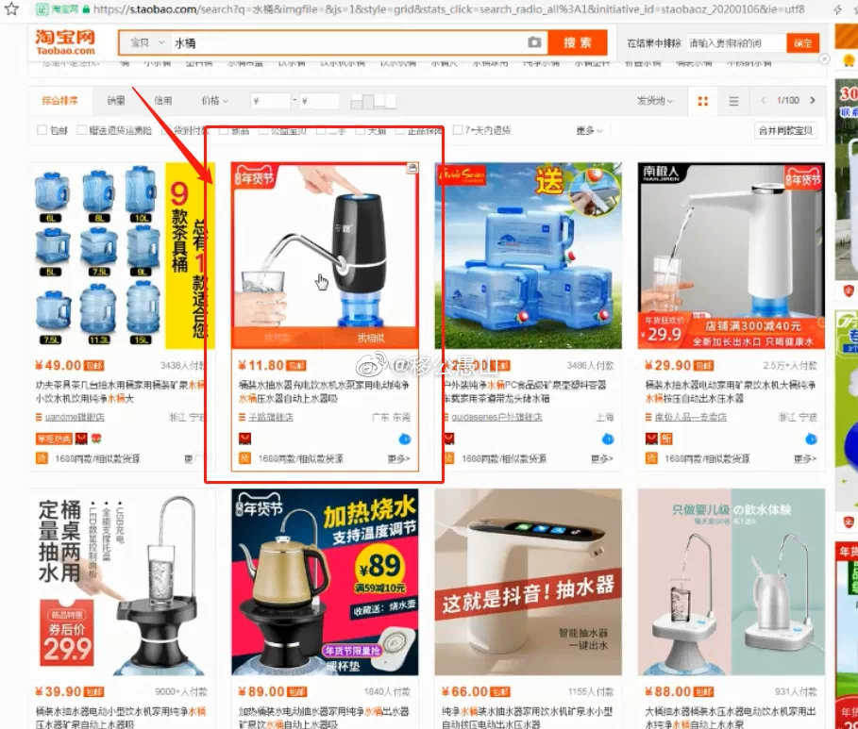
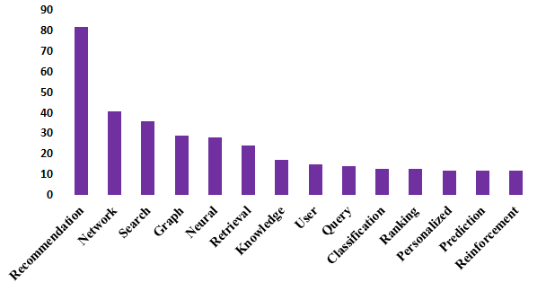
Background
01
Recommender Systems
Solve the “information overload”.
Huge commercial value: Amazon, YouTube, Alibaba et.al.
The proportion of related papers is increasing year by year.
SIGIR, IJCAI, CIKM, AAAI……

Slide 6
01 Background
02 Methods
03 Conclusion
04 Reference
CONTENTS

Slide 7
Methods
02
1
CTR Prediction
FNN、PNN、Wide&Deep、DeepFM、AutoFIS
2
Implicit feedback-based CF
RSs
DMF、NeuMF、CFNet
3
Sequential RSs
GRU4Rec、GRU4Rec-Sampling、Caser、RCNN、AttRec
…
Explainable RSs, POI RSs, Cold-start,…….

Slide 8
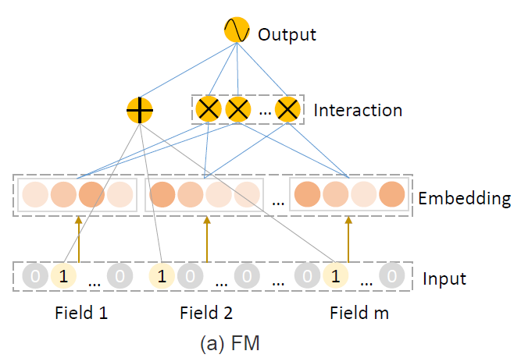
CTR Prediction
2-1
Click-Through-Rate Prediction
Task: Build a prediction model to estimate the probability that the user clicks on an item.
Key: Learn the complex feature interactions that underlie user behavior.
Model: Factorization Machine (FM)
One-order
Two-order
low-order
Age
Sex
…
Rating
Steffen Rendle. Factorization Machines. In ICDM. 2010: 995–1000

Slide 9
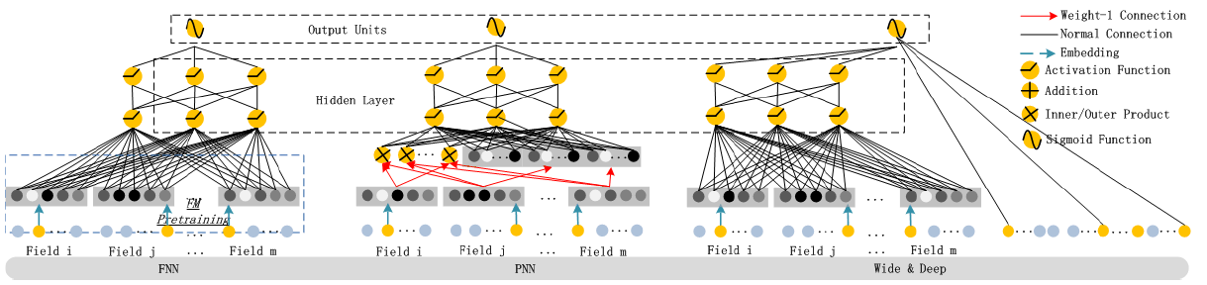
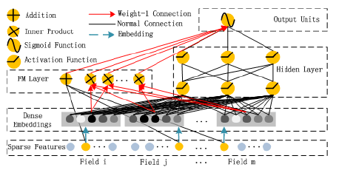
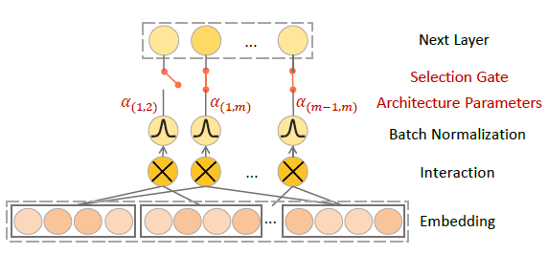
CTR Prediction
2-1
特征工程
DeepFM
AutoFIS

Slide 10
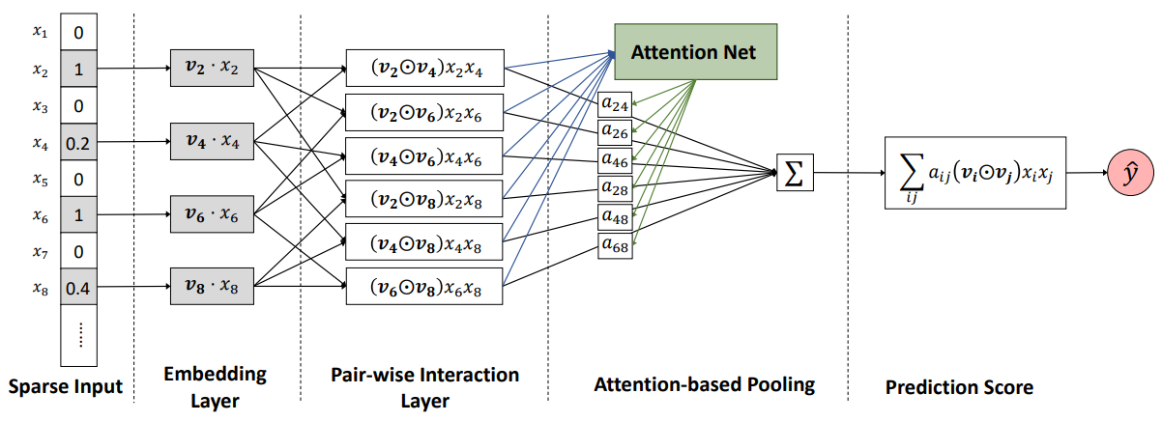
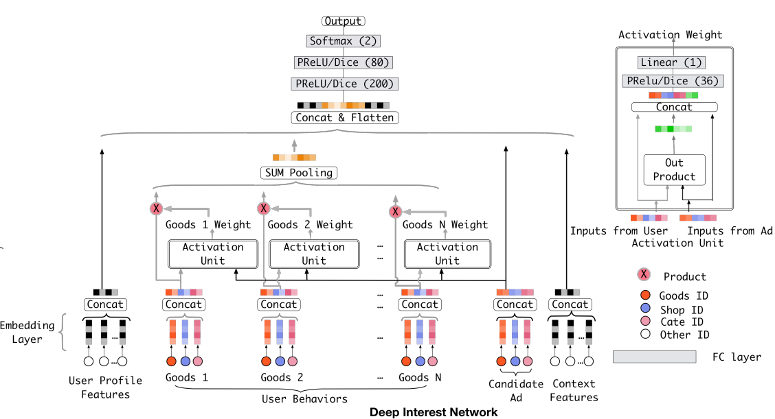
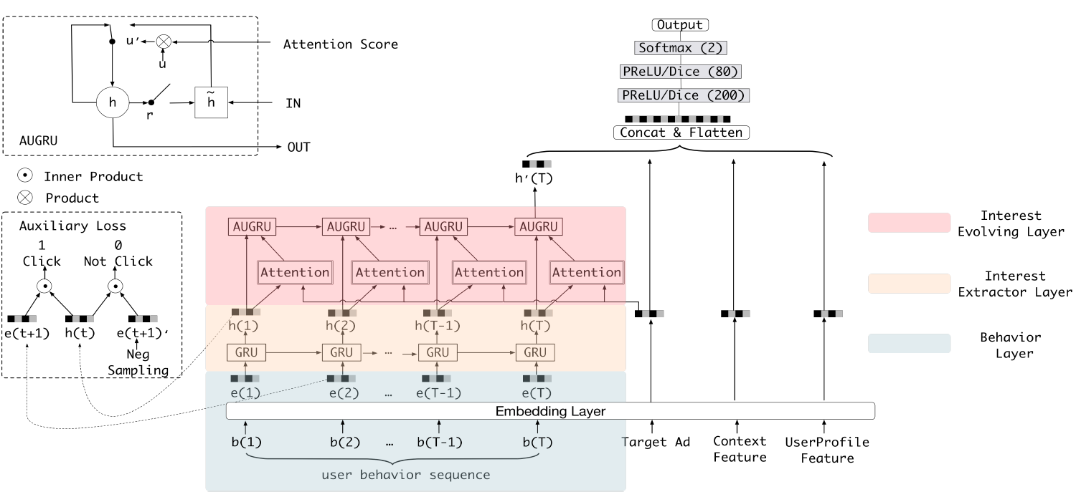
CTR Prediction
2-1
AFM
DIN
DIEN
结构上的改进进一步提升点击率预测：
采用Attention，RNN，RL等方法
后续开始关注其他问题：
如交互稀疏，冷启动等。

Slide 11
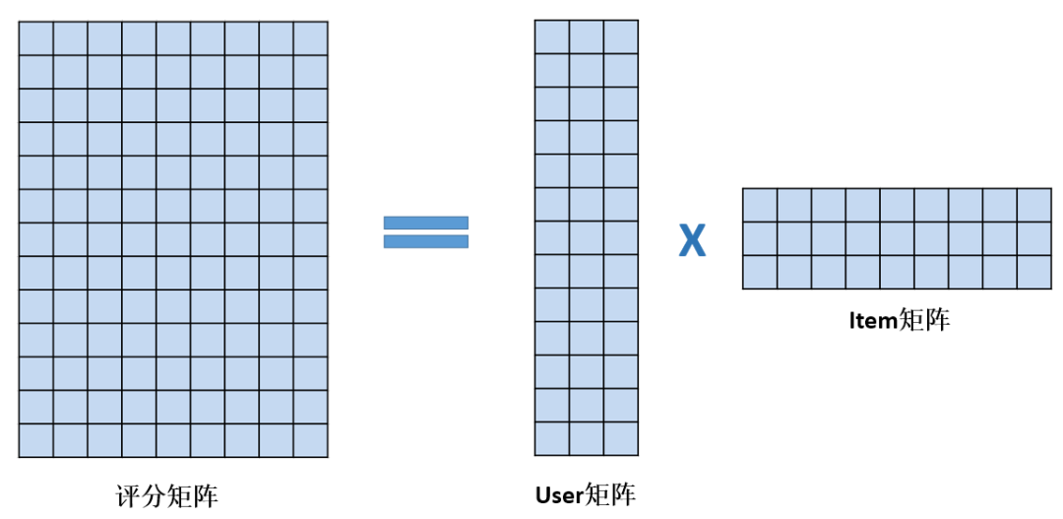
Implicit feedback-based CF
2-2
If you can’t get the statistical characteristics of users and items, How to predict the interaction probability?
Collaborative Filtering(CF) Matrix Factorization(MF)
Item Matrix
Interaction Matrix
User Matrix
http://sifter.org/~simon/journal/20061211.html

Slide 12
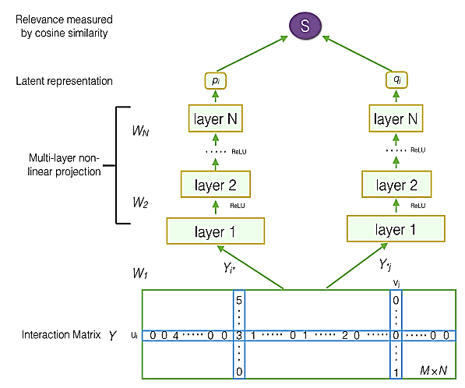
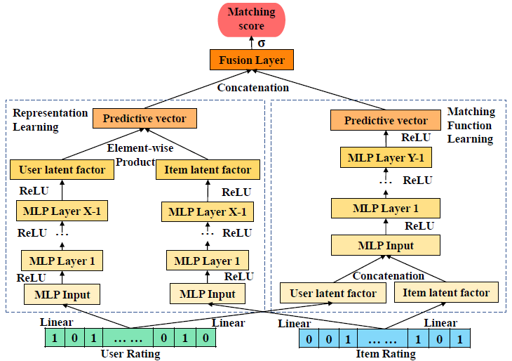
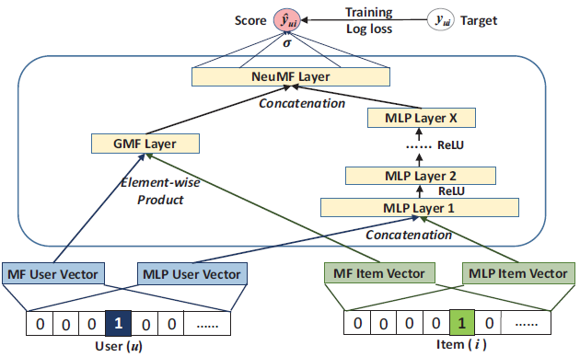
Implicit feedback-based CF
2-2
DMF
NeuMF
CFNet

Slide 13
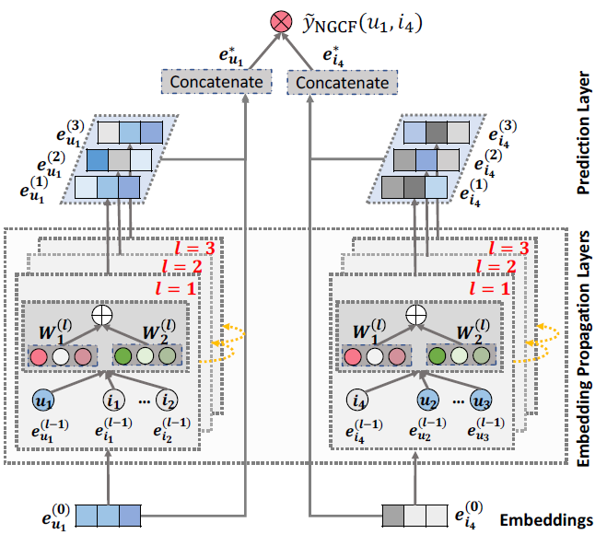
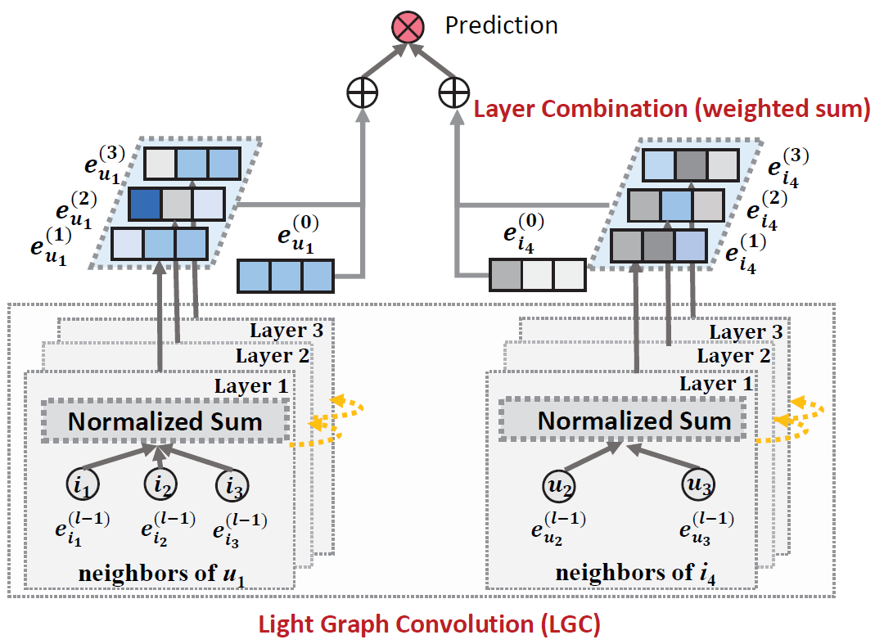
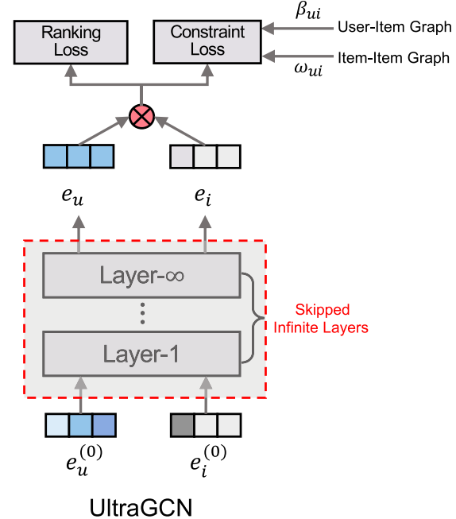
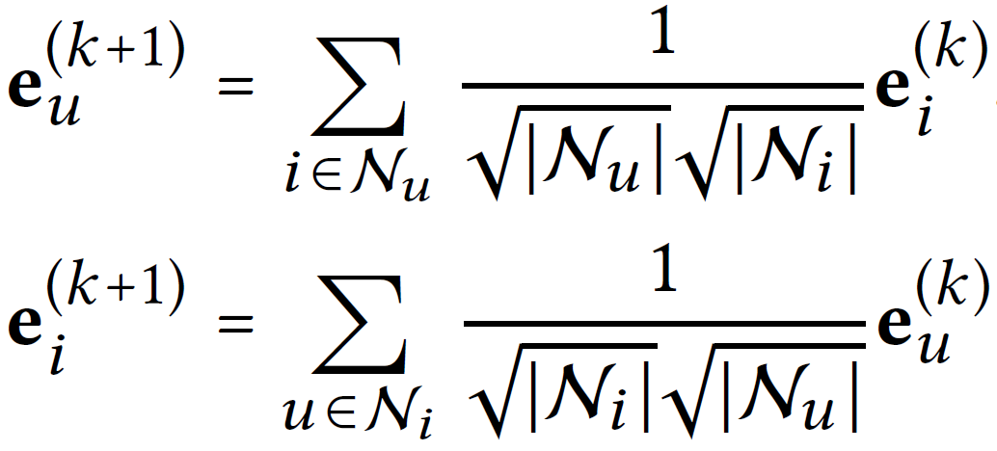
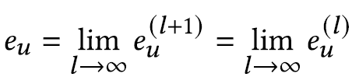
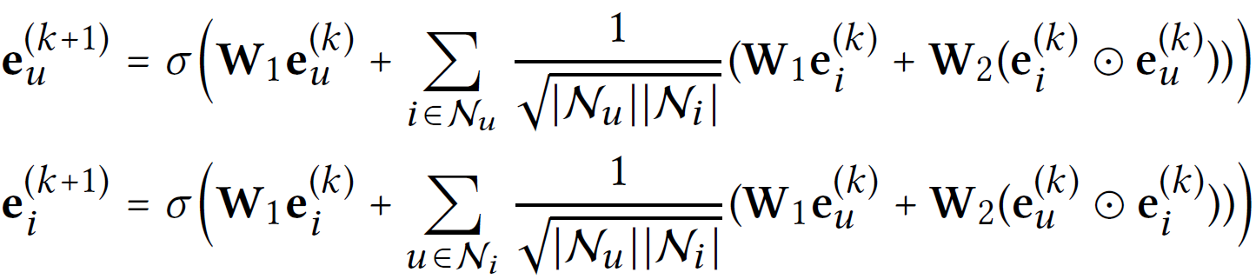
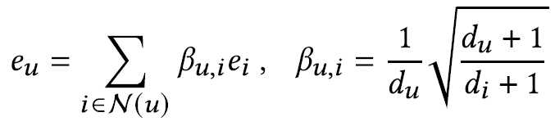
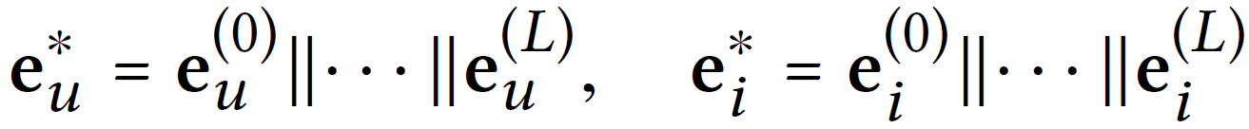
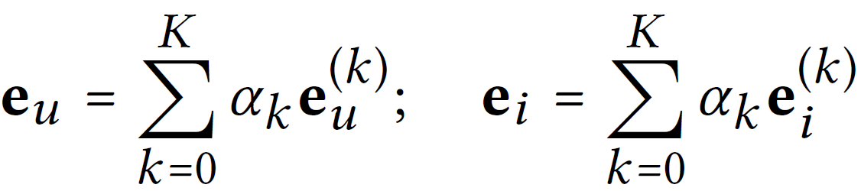
Implicit feedback-based CF
2-2
NGCF
LightGCN
UltraGCN

Slide 14
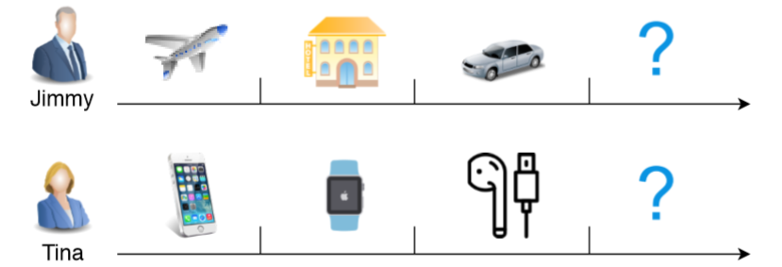
Sequential RSs
2-3
Sequential Recommendation Models
Each user as a sequence of items interacted in the past.
Aim to predict items that a user will likely interact in a “near future”.
The order of interaction implies that sequential patterns play an important role where more recent items in a sequence have a larger impact on the next item.

Slide 15
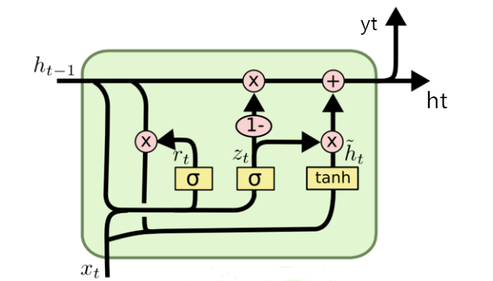
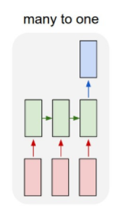
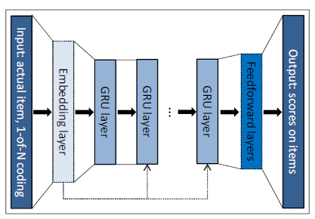
Sequential RSs
2-3
For a interaction sequence:
GRU4Rec
Firstly, Converts each item to a one-hot vector.
Then, encode the one-hot vector.
Next, follow n GRU to get the feature vector.
Finally, through a full-connected layer to get the probability that the user interacts with all items.
the first use of RNN in Sequential RSs
The architecture of GRU4Rec

Slide 16
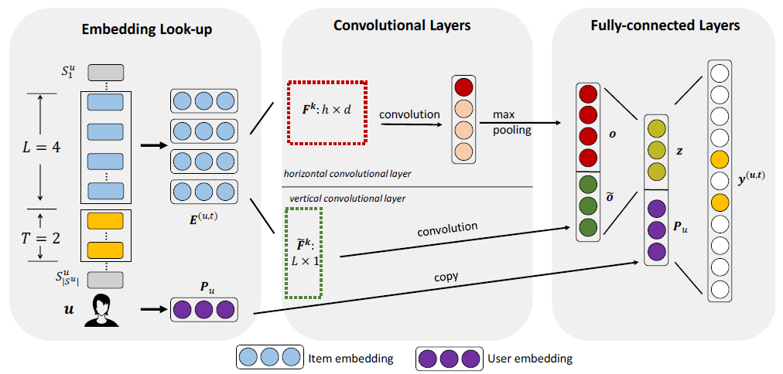
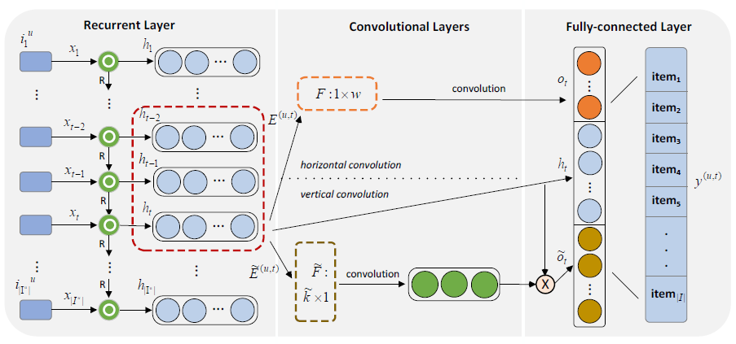
Sequential RSs
2-3
Caser
RCNN
The GRU model is used to capture temporal information.
Max-pooling operation is abandoned.
Horizontal convolution kernel:

Slide 17
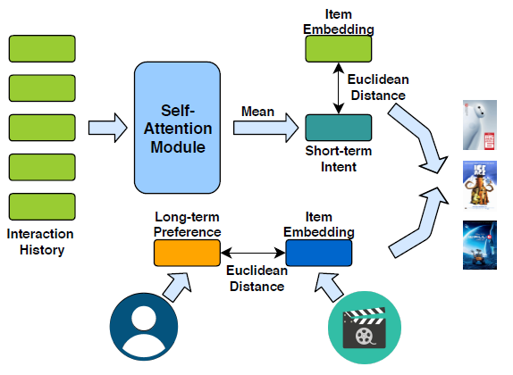
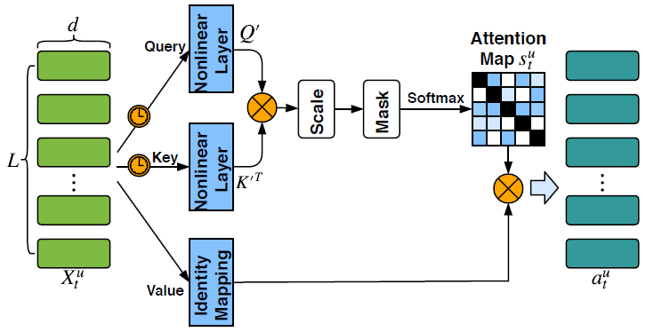
Sequential RSs
2-3
AttRec
The self-attention module.
The input is the embedding matrix of the latest interacted L items.
The output is the self-attentive representations.
The architecture of the AttRec. This model combines self-attention network with metric learning and considers both user’s short-term and long-term preference.

Slide 18
01 Background
02 Methods
03 Conclusion
04 Reference
CONTENTS

Slide 19
Conclusion
03
1. Described the background of RSs.
RSs Gradually becomes a research hotspot in academia and industry.
2. Introduced 3 research directions and related models.
CTR Prediction,
Implicit feedback-based CF,
Sequential RSs.

Slide 20
01 Background
02 Methods
03 Conclusion
04 Reference
CONTENTS

Slide 21
Reference
04
CTR Prediction
Guo H, Tang R, Ye Y, et al. DeepFM: a factorization-machine based neural network for CTR prediction. In Proceedings of the 26th International Joint Conference on Artificial Intelligence. 2017, 17: 1725–1731.
Zhang W, Du T, Wang J. Deep learning over multi-field categorical data. In Proceedings of European conference on information retrieval. 2016: 45-57.
Qu Y, Cai H, Ren K, et al. Product-based neural networks for user response prediction. In Proceedings of the 16th International Conference on Data Mining. 2016: 1149-1154.
Cheng H T, Koc L, Harmsen J, et al. Wide & deep learning for recommender systems. In Proceedings of the 1st workshop on deep learning for recommender systems. 2016: 7-10.
Liu B, Zhu C, Li G, et al. AutoFIS: Automatic Feature Interaction Selection in Factorization Models for Click-Through Rate Prediction. In Proceedings of the 26th ACM SIGKDD International Conference on Knowledge Discovery & Data Mining. 2020: 2636–2645.
Implicit feedback-based CF
Xue H J, Dai X, Zhang J, et al. Deep Matrix Factorization Models for Recommender Systems. In Proceedings of the 26th International Joint Conference on Artificial Intelligence. 2017, 17: 3203-3209.
He X, Liao L, Zhang H, et al. Neural collaborative filtering. In Proceedings of the 26th international conference on world wide web. 2017: 173-182.
Deng Z H, Huang L, Wang C D, et al. Deepcf: A unified framework of representation learning and matching function learning in recommender system. In Proceedings of the AAAI Conference on Artificial Intelligence. 2019, 33: 61-68.
Sequential RSs
Hidasi B, Karatzoglou A, Baltrunas L, et al. Session-based recommendations with recurrent neural networks. arXiv:1511.06939, 2015.
Hidasi B, Karatzoglou A. Recurrent neural networks with top-k gains for session-based recommendations. In Proceedings of the 27th ACM International Conference on Information and Knowledge Management. 2018: 843-852.
Tang J, Wang K. Personalized top-n sequential recommendation via convolutional sequence embedding. In Proceedings of the Eleventh ACM International Conference on Web Search and Data Mining. 2018: 565-573.
Xu C, Zhao P, Liu Y, et al. Recurrent convolutional neural network for sequential recommendation. In Proceedings of the World Wide Web Conference. 2019: 3398-3404.
Zhang S, Tay Y, Yao L, et al. Next Item Recommendation with Self-Attentive Metric Learning. In Proceedings of the AAAI Workshop on Recommender Systems and Natural Language Processing. 2019.
Explainable RSs
Chen Z, Wang X, Xie X, et al. Co-Attentive Multi-Task Learning for Explainable Recommendation. In Proceedings of the 28th International Joint Conference on Artificial Intelligence. 2019: 2137-2143.
Li L, Zhang Y, Chen L. Generate Neural Template Explanations for Recommendation. In Proceedings of the 29th ACM International Conference on Information & Knowledge Management. 2020: 755-764.

Slide 22
Thanks for your listening
Candidate: Zhiqiang Guo
Major: Computer Software and Theory
Course: Information Retrieval
Date: December 16th, 2020

